Slide 1
Digital Signal Processing Final Term Presentation
Name:- Debapriya Das
ID:-M0829022
Professor: Ren-Yuan Lyu

Slide 2
Outline
DSP Assignment
Research Progress
Python Code: Game-Pong

Slide 3
Outline
DSP Assignment
Research Progress
Python Code: Game-Pong

Slide 4
Contents
Chapter Two (Harmonics)
Chapter Three (Non-periodic signals)
Chapter Four (Noise)

Slide 5
Chapter II HARMONICS

Slide 6
DSP Exercise 2.1
If you use Jupyter, load chap02.ipynb and try out the examples. You can also view the notebook at http://tinyurl.com/thinkdsp02

Slide 7
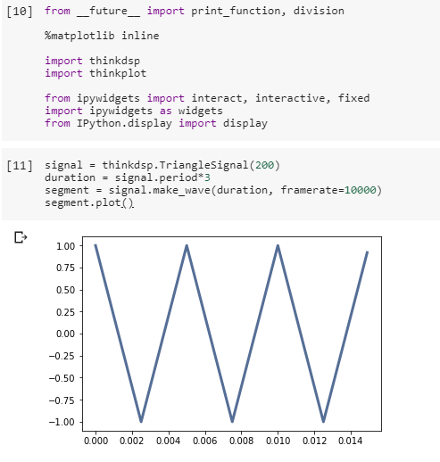
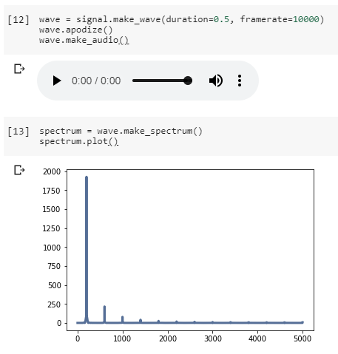
Digital Signal Processing Assignment
Output Answer:

Slide 8
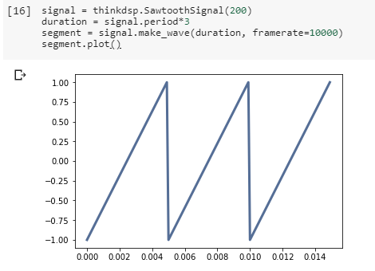
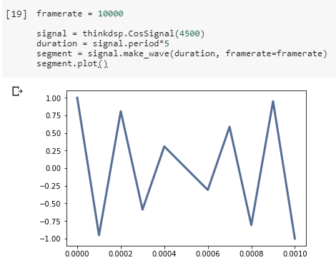
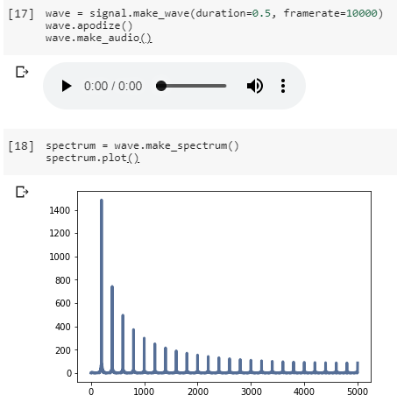
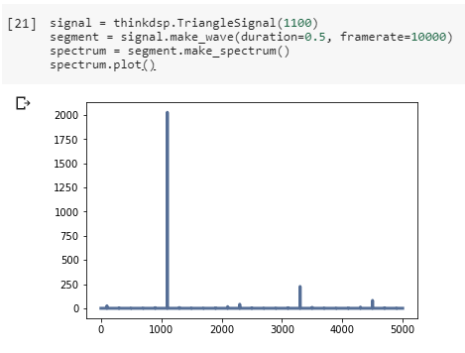
Digital Signal Processing Assignment

Slide 9
Chapter III NON-PERIODIC SIGNALS

Slide 10
DSP Exercise 3.1
Run and listen to the examples in chap03.ipynb, which is in the repository for this book, and also available at http://tinyurl.com/thinkdsp03. In the leakage example, try replacing the Hamming window with one of the other windows provided by NumPy, and see what effect they have on leakage. See http://docs.scipy.org/doc/numpy/reference/routines. window.html

Slide 11
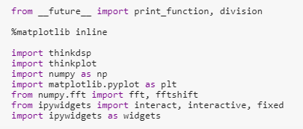
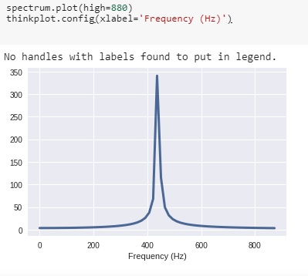

Digital Signal Processing Assignment

Slide 12
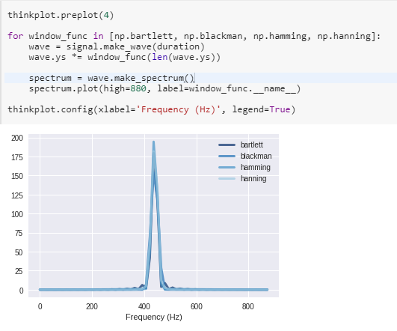
Digital Signal Processing Assignment

Slide 13
Chapter IV NOISE

Slide 14
DSP Exercise 4.1
A Soft Murmur” is a web site that plays a mixture of natural noise sources, including rain, waves, wind, etc. At http://asoftmurmur. com/about/ you can find their list of recordings, most of which are at http://freesound.org. Download a few of these files and compute the spectrum of each signal. Does the power spectrum look like white noise, pink noise, or Brownian noise? How does the spectrum vary over time?

Slide 15
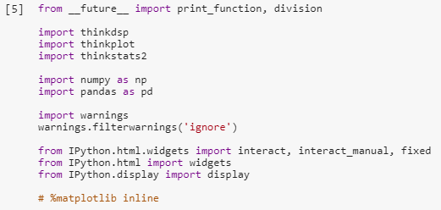
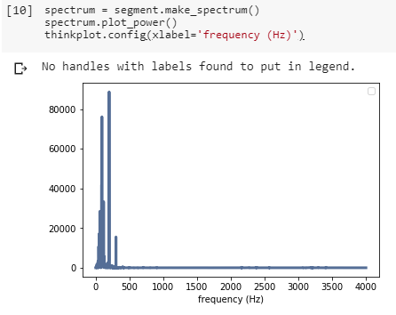
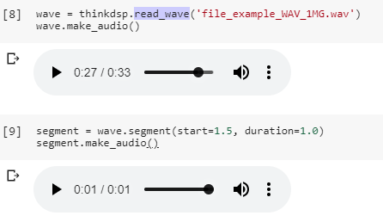
Digital Signal Processing Assignment

Slide 16
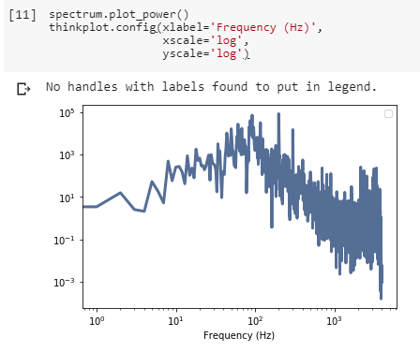
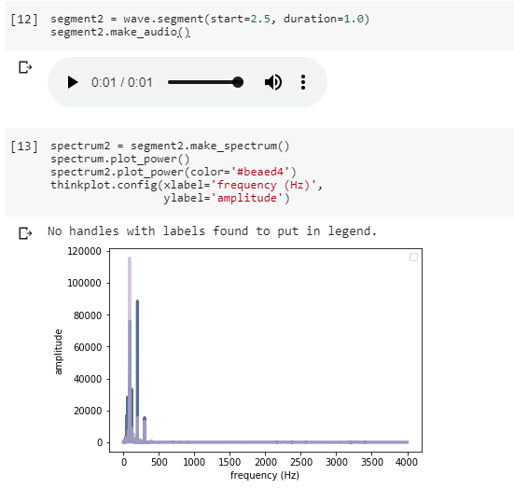
Digital Signal Processing Assignment

Slide 17
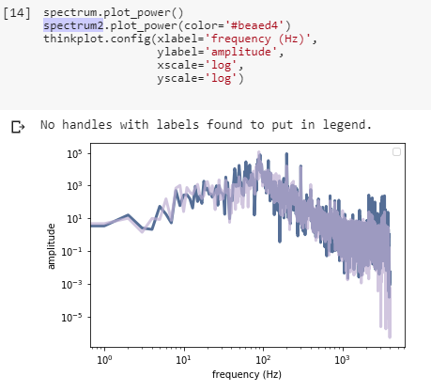
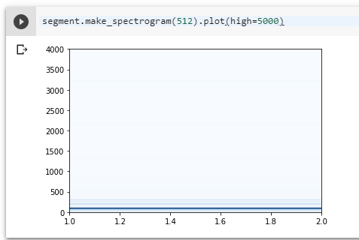
Digital Signal Processing Assignment

Slide 18
Outline
DSP Assignment
Research Progress
Python Code: Game-Pong

Slide 19
Review of Deep Learning Models for Object Detection
Research Progress

Slide 20
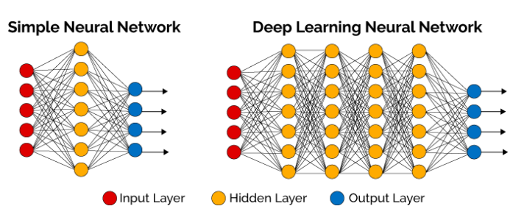
Introduction : Deep Learning
Deep Learning
It is a machine learning technique that teaches computers to do what comes naturally to humans: learn by example
The term “deep” usually refers to the number of hidden layers in the neural network.
Deep learning models are trained by using large sets of labelled data and neural network architectures that learn features directly from the data without the need for manual feature extraction.

Slide 21
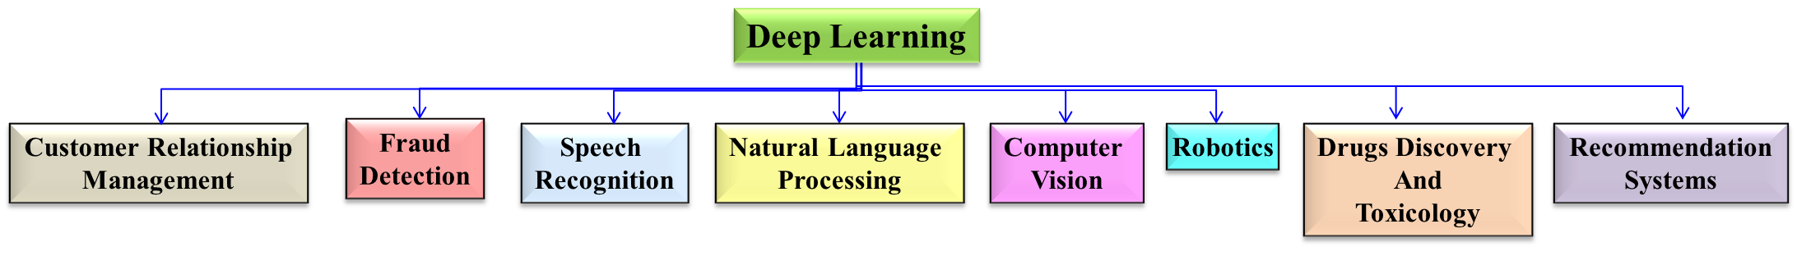
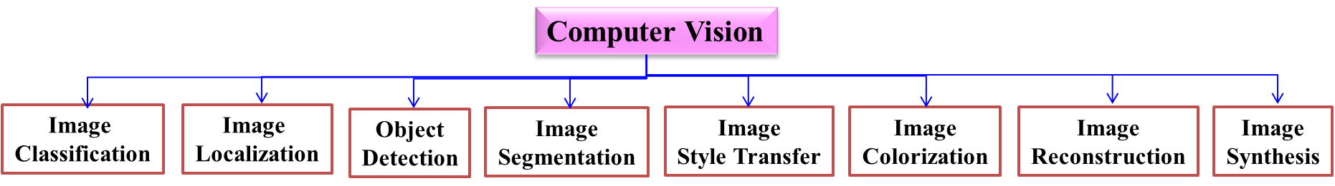
Application of Deep Learning

Slide 22



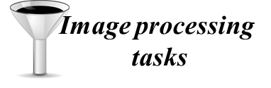
Introduction: Data type & image data analysis
Data Type
Text
Image
Audio
Video
Image Data Analysis
INPUT
PRE PROCESSING
ANALYSIS
OUTPUT

Slide 23
Introduction: Object detection
Object detection methods
With Machine Learning
With Deep Learning
Sliding window based
(3 stage detectors)
Regression based
(1 stage detector)
Region based
(2 stage detectors)
Viola and Jones
YOLO
RCNN
HOG
SSD
SPPNet
DPM
Fast RCNN
Faster RCNN
According to [32], popular algorithms are:

Slide 24





Viola & Jones
The 1st efficient object detection algorithm was a Face Detector in 2001 by Paul Viola & Michael Jones.
Real
SVM
Local Binary Pattern(LBP)
Not-Real

Slide 25
Introduction: Object detection
Object detection methods
With Machine Learning
With Deep Learning
Sliding window based
(3 stage detectors)
Regression based
(1 stage detector)
Region based
(2 stage detectors)
Viola and Jones
YOLO
RCNN
HOG
SSD
SPPNet
DPM
Fast RCNN
Faster RCNN
According to [32], popular algorithms are:

Slide 26
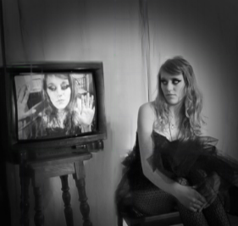
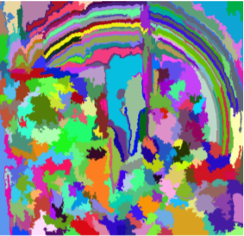


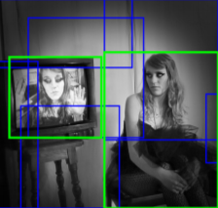
With Deep Learning: Region Based (2 stage detectors)
Goal: Lady
Where is the object?
What is the object?
Need to search a Lady in the input image
Input
Region proposal
Selective search*
Except Faster R-CNN (Region Proposal Network (RPN))
Hierarchical grouping
Bottom-up grouping
1st stage
Input
Grouping method (+Felzenszwalb)
Recursively combine similar regions into larger ones
Use generated regions to produce candidate object locations
Minimum spanning tree clustering (Graph theory)
Greedy algorithm
Region proposals
Similarities is based on features such as color space, texture, size and shape

Slide 27

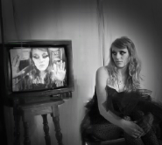

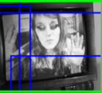
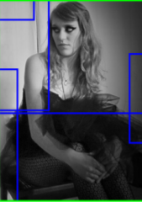
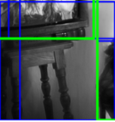
With Deep Learning: Region Based (2 stage detectors)
Goal: Lady
Where is the object?
What is the object?
Need to search a Lady in the input image
Input
Region proposal
Classifier
Output
Lady
Lady
CNN
Bounding box
Classification class
1st stage
2nd stage
Cropped candidate object locations
…
CNN
Wrapped into same size
All candidates with the same size
…

Slide 28
With Deep Learning: Region Based (2 stage detectors)
Goal: Lady
Where is the object?
What is the object?
Need to search a Lady in the input image
Input
Region proposal
Classifier
Output
CNN
1st stage
2nd stage
Drawbacks:
Quite slow process due to huge numbers of generated region proposals (e.g. 2000 region in R-CNN)
Selective search is a fixed algorithm. Therefore, no learning is happening at that stage which could lead to the generation of bad candidate region proposals
Cannot be used for real-time object detection due to time execution in testing phase

Slide 29
Introduction: Object detection
Object detection methods
With Machine Learning
With Deep Learning
Sliding window based
(3 stage detectors)
Regression based
(1 stage detector)
Region based
(2 stage detectors)
Viola and Jones
YOLO
RCNN
HOG
SSD
SPPNet
DPM
Fast RCNN
Faster RCNN
According to [32], popular algorithms are:

Slide 30
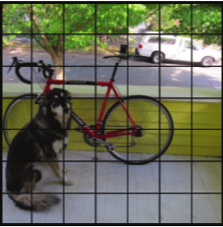
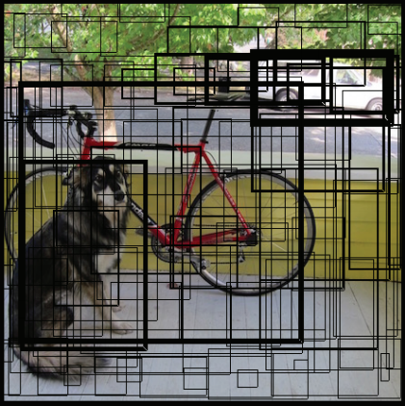
Yolo
You Only Look Once(Yolo) divides the image into a 13 x 13.
Each grid purpose 5 bounding boxes predicting objects in the image.
It predicts weather a bounding box encloses an object class C or not by checking the confidence score.

Slide 31
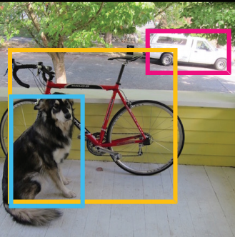
Yolo
Each bounding box consists of 5 predictions : x, y, w, h and confidence.
x, y represent the center of the bounding box.
w, h are predicted to the whole image.
C is the confidence score represents the intersection over union between the predicted bounding box and ground truth box.
https://arxiv.org/pdf/1506.02640.pdf

Slide 32
Outline
DSP Assignment
Research Progress
Python Code: Game-Pong

Slide 33
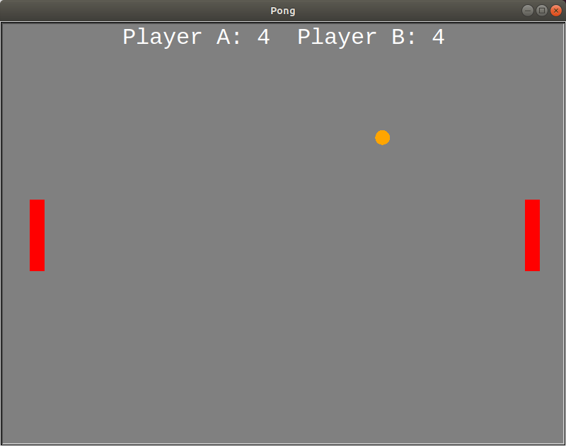

Slide 34

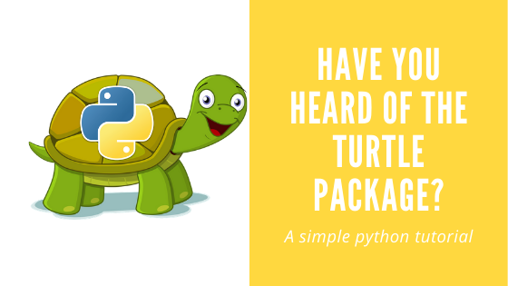
Introduction
Pong is like a table tennis sports game.
It’s a two player game.
Codes
Turtle is a python module which helps for drawing graphics.
It is used for drawing blocks in the game.

Slide 35
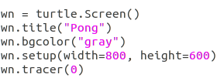
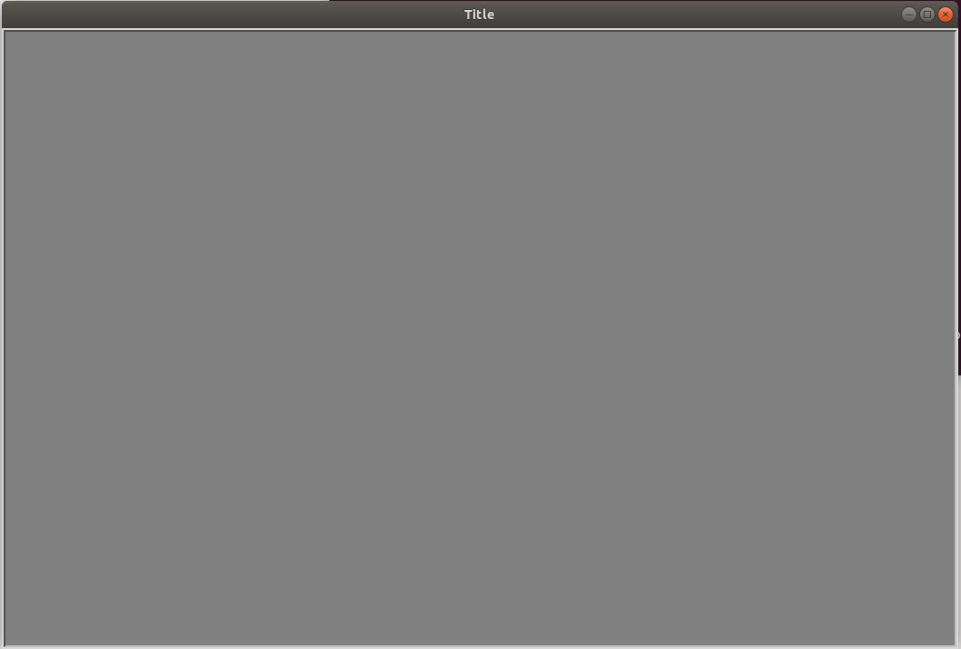
It gives the title to the window.
It gives background color.
Height and Width to the window.
It helps in speeding up the game.
Its is also used for animation.

Slide 36
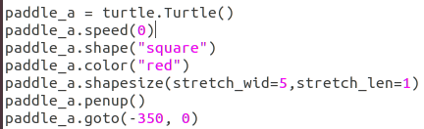
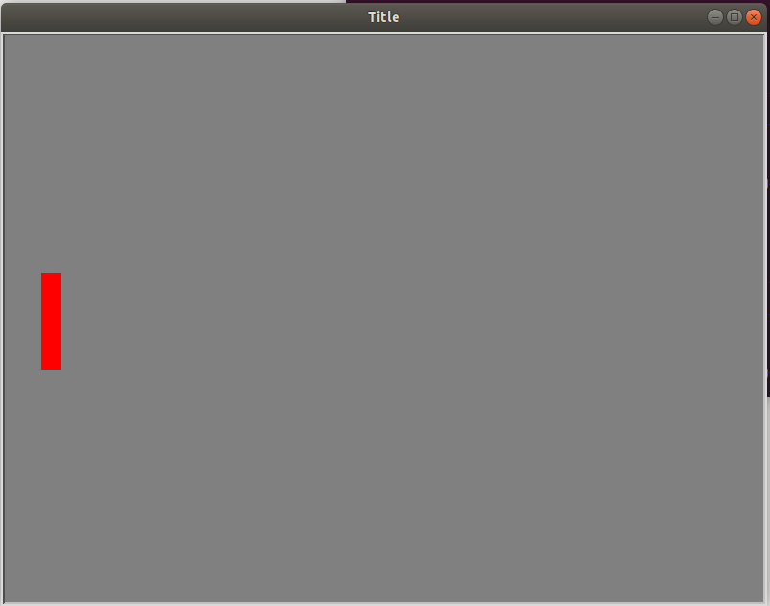
A object to deflect the ball or a bat.
It helps to speed up the moments.
It is shape of the paddle.
It is the color of the paddle.
It helps to give required size to the paddle, default size is 20X20 pixels, it increases by the given number of times of the default size.
It is the coordinates of the paddle.

Slide 37
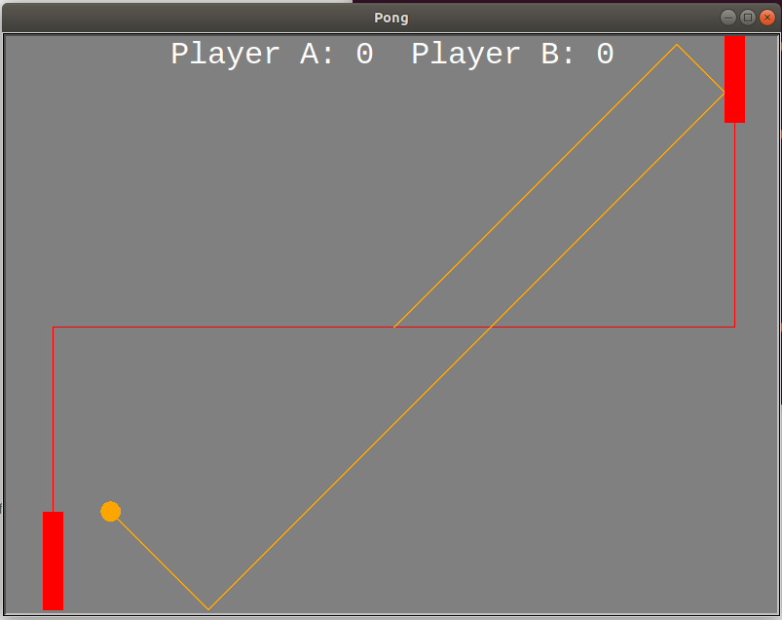
It leaves a mark or a track behind.
It draws wherever it goes.

Slide 38
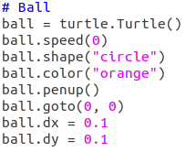
User defined variable of Turtle class.
It describes the color, shape of the ball.
It’s Coordinates to begin every time the game starts or one person losses.
It’s coordinates to change the position for next moment.

Slide 39
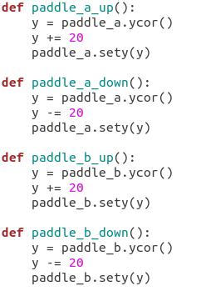
Paddle_a
It helps in moving the paddle up and down by 20 pixels.
It returns the current y coordinate value of the paddle.
It adds 20 to the y coordinate value.
It sets the new coordinates to the paddle.
Paddle_b

Slide 40
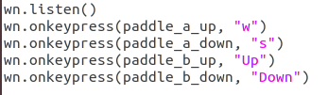
It pre defined function in turtle to take input from keyboard.
It helps in moving the paddle up and down.
It is case sensitive.
Up and Down are the up and down cursor in the keyboard.

Slide 41

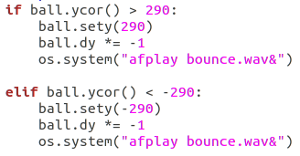
It is used to move the ball in the window.
It bounces the ball from top and bottom of the window.

Slide 42
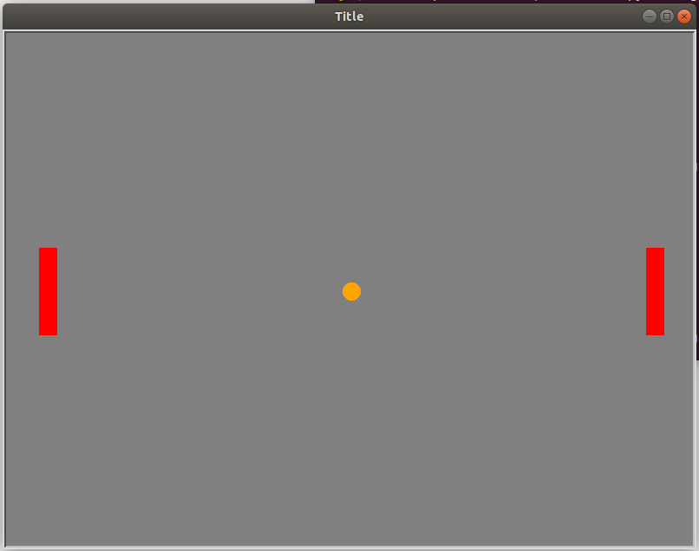
x,y
x,-y
0,0
-x,y
-x,-y
Here y coordinate plays the important role in bouncing the walls in top and bottom.

Slide 43
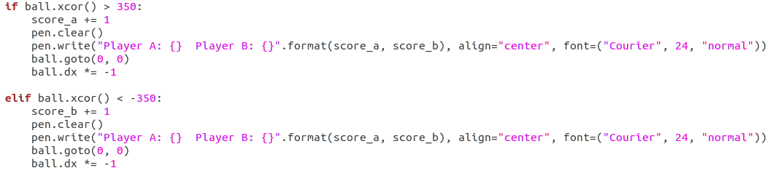
Ball did not touch the paddle.
Score will increase.
Ball will restart from the middle or (0,0) coordinate.
Ball will move towards the winner of the previous round.
Similarly for other player.

Slide 44
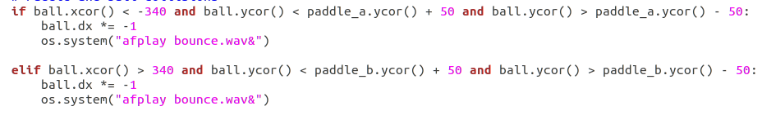
~ -340,y
-350,0
350,0
~ 265,y

Slide 45

Similarly for other paddle.
Future Work
It can be used to develop football as well as hockey.

Slide 46
Thank You

